Slide 1

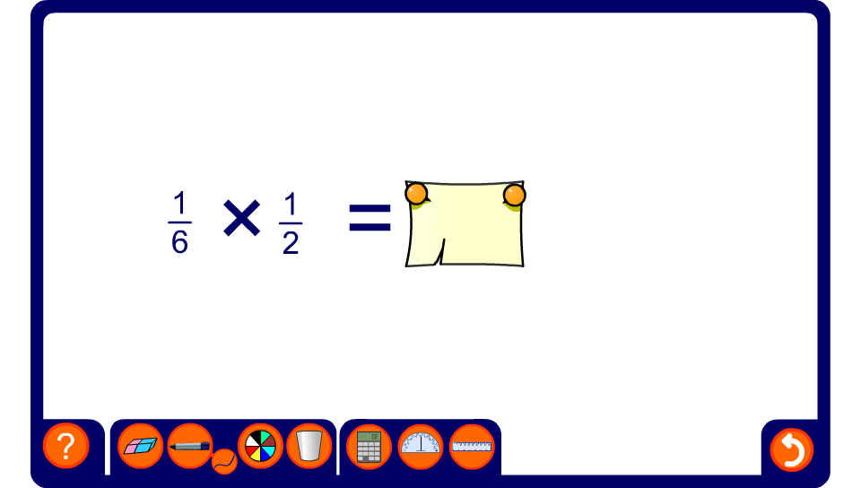


Multiplying fractions

